Slide 1
Chapter 2

Slide 2
Objectives

Slide 3
Objectives (cont.)

Slide 4
Objectives (cont.)

Slide 5
The Python code for a Test Scores program

Slide 6
An indentation error

Slide 7
Two ways to continue one statement over two or more lines

Slide 8
Coding rules

Slide 9
The Test Scores program with comments

Slide 10
The Test Scores program with comments (cont.)

Slide 11
Guidelines for using comments

Slide 12
The syntax for calling any function

Slide 13
Three Python data types

Slide 14
Code that initializes variables and assigns data

Slide 15
How to code literal values

Slide 16
Rules for naming variables

Slide 17
Python keywords

Slide 18
Two naming styles for variables

Slide 19
Python’s arithmetic operators

Slide 20
Examples with two operands

Slide 21
The order of precedence

Slide 22
Examples that show the order of precedence and use of parentheses

Slide 23
Code that calculates sales tax

Slide 24
The most useful compound assignment operators

Slide 25
More compound assignment operator examples

Slide 26
A floating-point result that isn’t precise

Slide 27
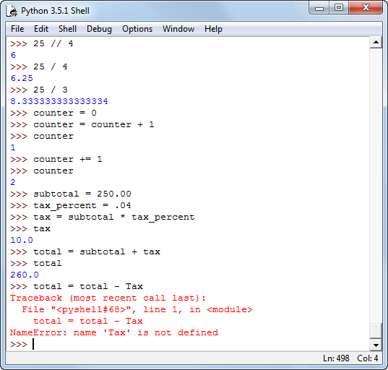
The Python shell after some numeric testing

Slide 28
How to use the shell

Slide 29
How to assign strings to variables

Slide 30
The str() function

Slide 31
Common escape sequences

Slide 32
The new line character

Slide 33
The backslash in a Windows path

Slide 34
Implicit continuation of a string over several lines

Slide 35
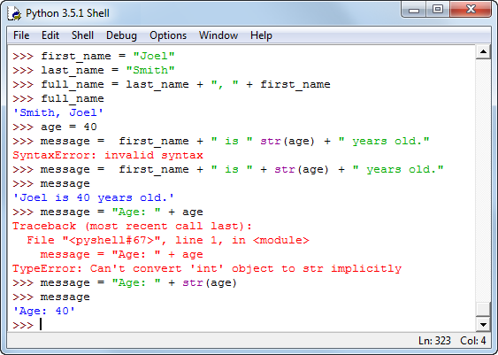
The Python shell with string testing

Slide 36
How to use the shell

Slide 37
The syntax of the print() function

Slide 38
Two ways to get the same result

Slide 39
Examples that use the sep and end arguments

Slide 40
The input() function

Slide 41
Another way to get input from the user

Slide 42
Code that attempts to get numeric input

Slide 43
Three functions for working with numbers

Slide 44
Code that gets an int value from the user

Slide 45
Code that gets a float value from the user

Slide 46
Code that uses the round() function

Slide 47
The console

Slide 48
The code

Slide 49
The console

Slide 50
The code

